Slide 1
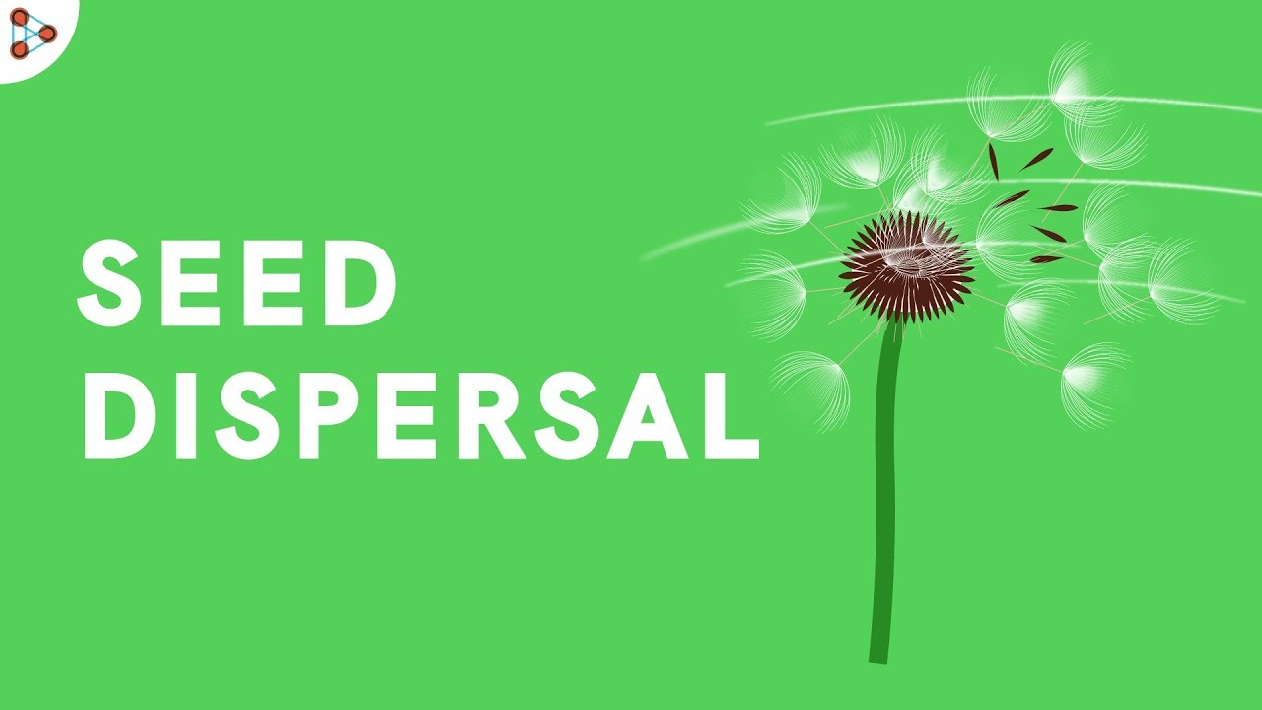
Introduction: Watch vid - BBC Bitesize - Seeds and Seed Dispersal

Slide 2
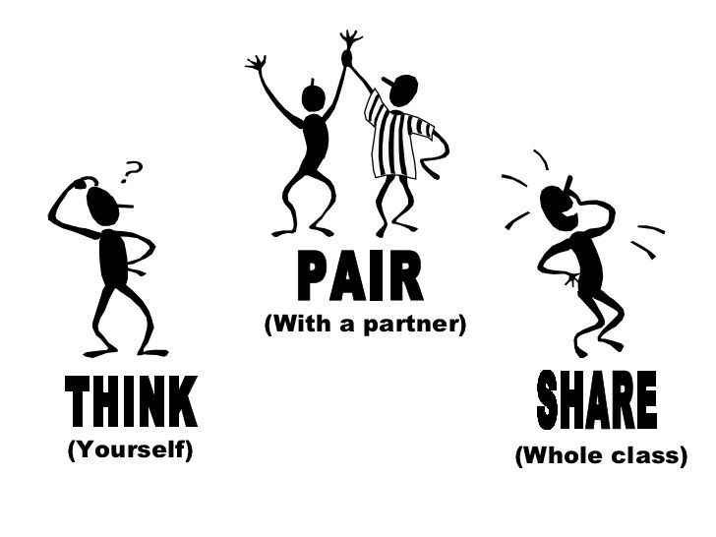
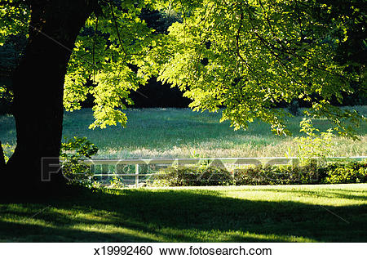
Investigating Seed Dispersal
Plants have many ways of dispersing (spreading out their seeds). But why do they do this?
Clue - Why might another tree find it hard to grow here?

Slide 3
Investigating Seed Dispersal
Task 1 - Make your Sycamore seeds
Task 2 - Discuss the following question
How does the weight of a Sycamore seed affect the time it takes to fall?
Task 3 - Investigate using the instruction sheet to guide you

