Slide 1
Year 1 Maths

Slide 2
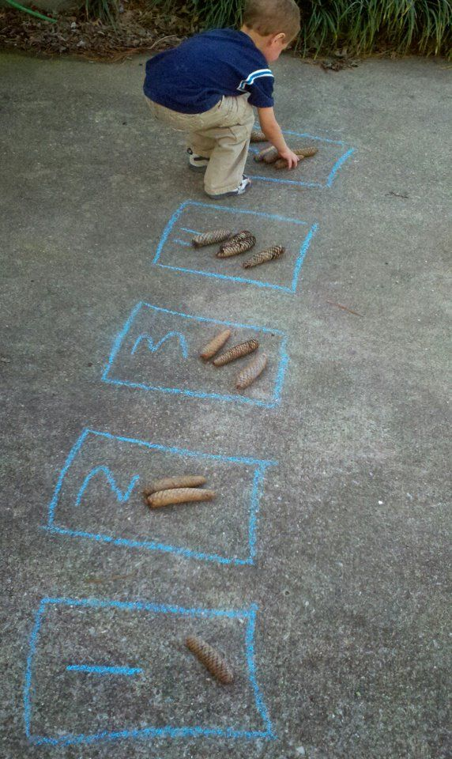
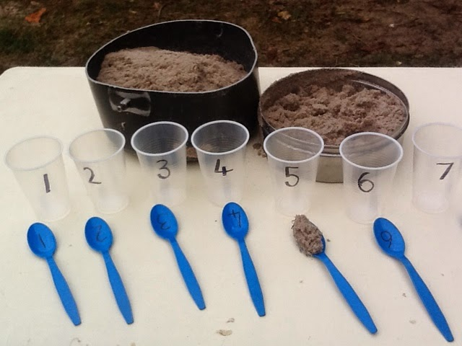
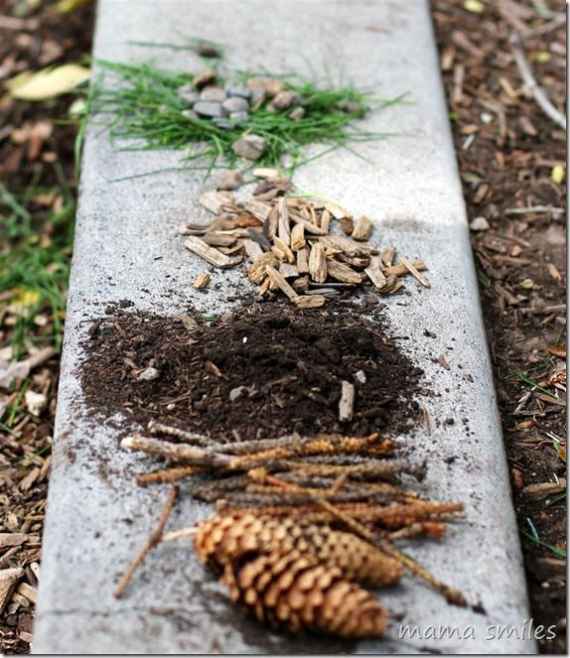
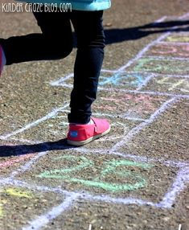
Addition and subtraction We are learning to add and takeaway numbers to 100.
Practical Ideas…
Practise counting to 20 then 100 using a song or video online.
Practice writing ten and teen numbers in messy play e.g. 13 and 30.
Use sticks to make numbers. Collect items to show the numbers.
Play ‘paint the square’ on top marks online.
Practise adding one more and one less from any number.
Count leaves, stones and sticks. Practise taking a number away.
Play addition and subtraction games on top marks online.
Roll dice and add the numbers together.
Play board games with the family.

Slide 3
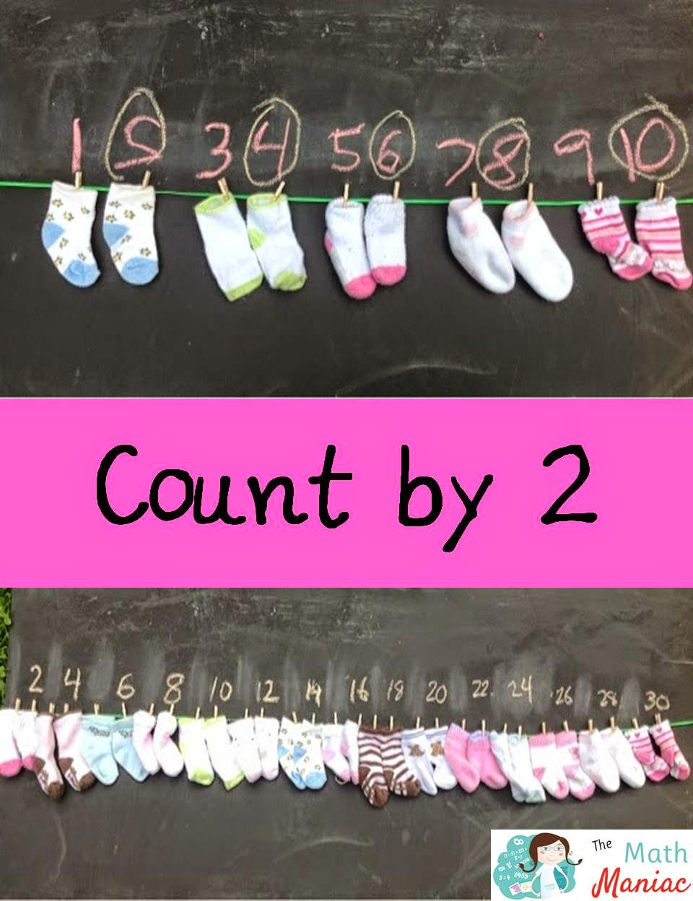
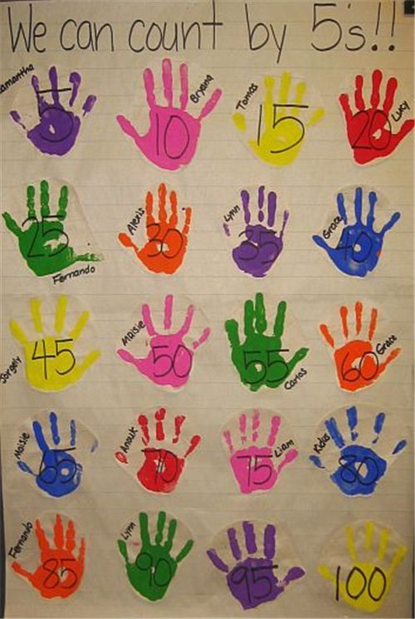
Multiplication We are learning to count in 2’s, 5’s and 10’s.
Practical Ideas…
Count pairs of socks
Paint handprints and label 5 times tables
Practise counting in 2’s, 5’s and 10’s using a song or video online.
Play hit the button on top marks.
Place objects and toys into groups of 2’s, 5’s and 10’s.
Count leaves, stones and sticks. Place them in lines and rows of 2’s, 5’s and 10’s.

Slide 4
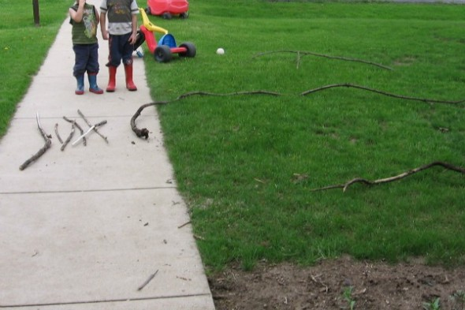
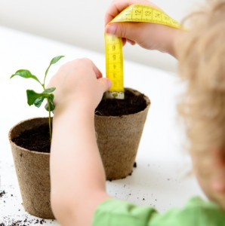
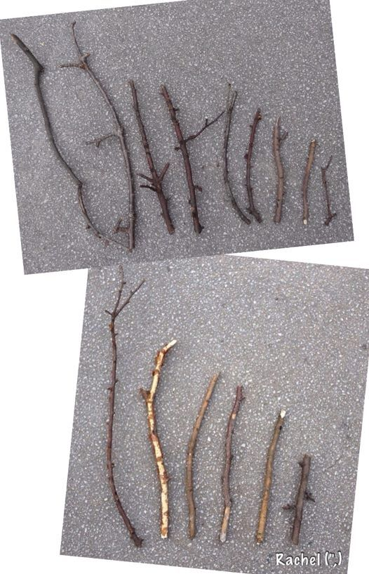
Measure We are learning to measure.
Practical Ideas…
Draw around your feet and put the feet in order or size. How many pennies long are each foot? Use a ruler to measure feet in cm. Which are more than 10cm? Which are less than 10cm?
Cut string into different lengths. Place in order.
Place toys in order of size. Say which is largest and smallest.
Follow a recipe and measure ingredients using cupful's.
Place objects in order or weight. Say which is greater than or less than.
Play with jugs and containers in water or the bath.

