Slide 1
Reception Maths

Slide 2
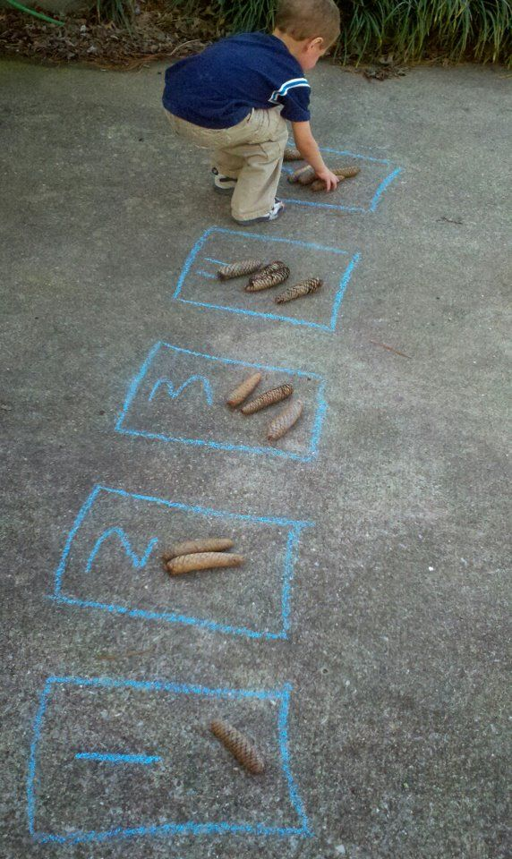
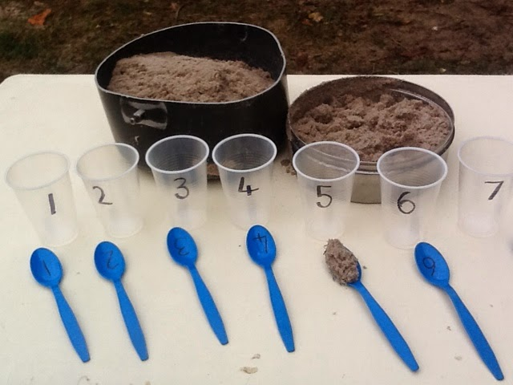
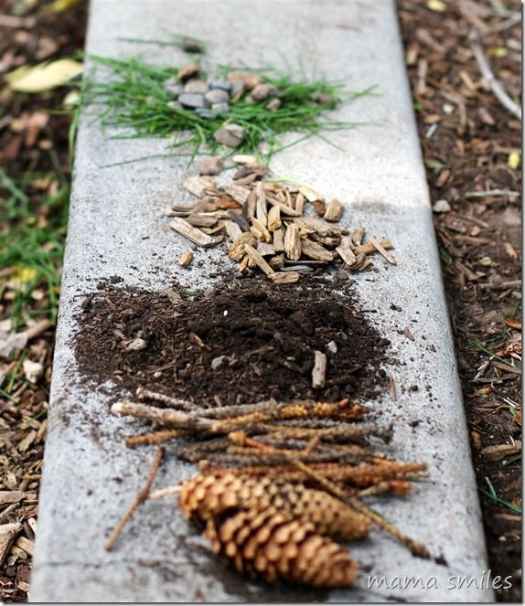
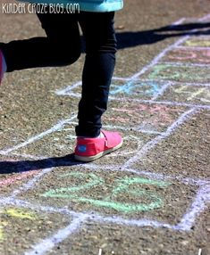
Addition and subtraction We are learning to add and takeaway numbers to 20.
Practical ideas…
Practise counting to 20 then 50 using a song or video online.
Practice writing ten and teen numbers in messy play.
Use sticks to make numbers. Collect items to show the numbers.
Play ‘paint the square’ on top marks online.
Practise adding one more and one less from any number.
Count leaves, stones and sticks. Practise taking a number away.
Play addition and subtraction games on top marks online.
Play board games with the family.

Slide 3
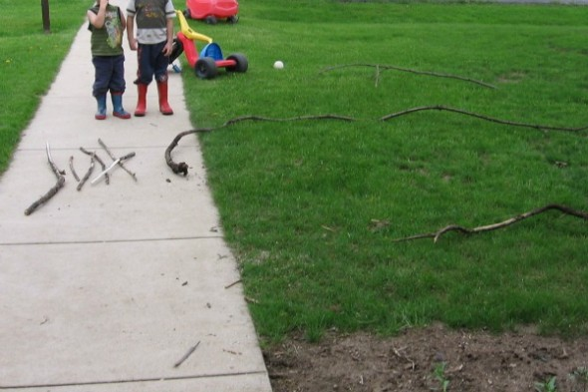
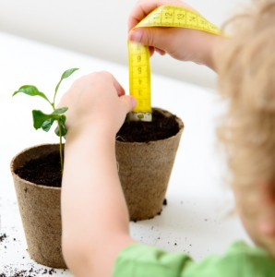
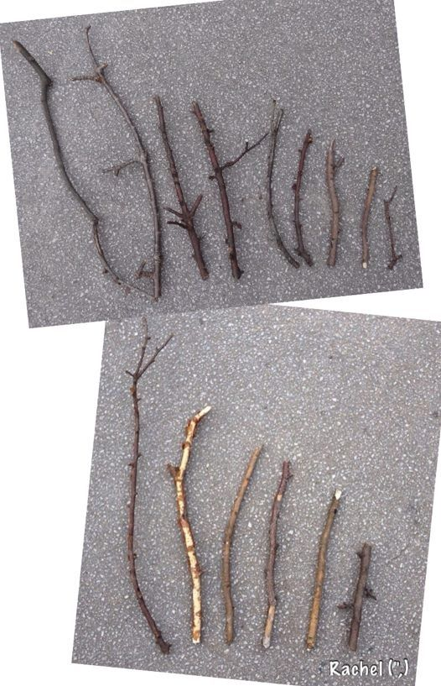
Measure We are learning to measure.
Practical ideas…
Draw around your feet and put the feet in order or size. How many pennies long are each foot? Use a ruler to measure feet in cm.
Cut string into different lengths. Place in order.
Place toys in order of size. Say which is largest and smallest.
Follow a recipe and measure ingredients using cupful's.
Place objects in order or weight. Say which is greater than or less than.
Play with jugs and containers in water or the bath.

Slide 4
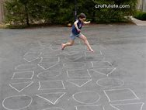
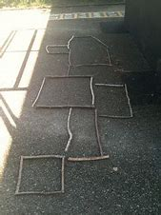
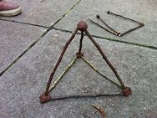
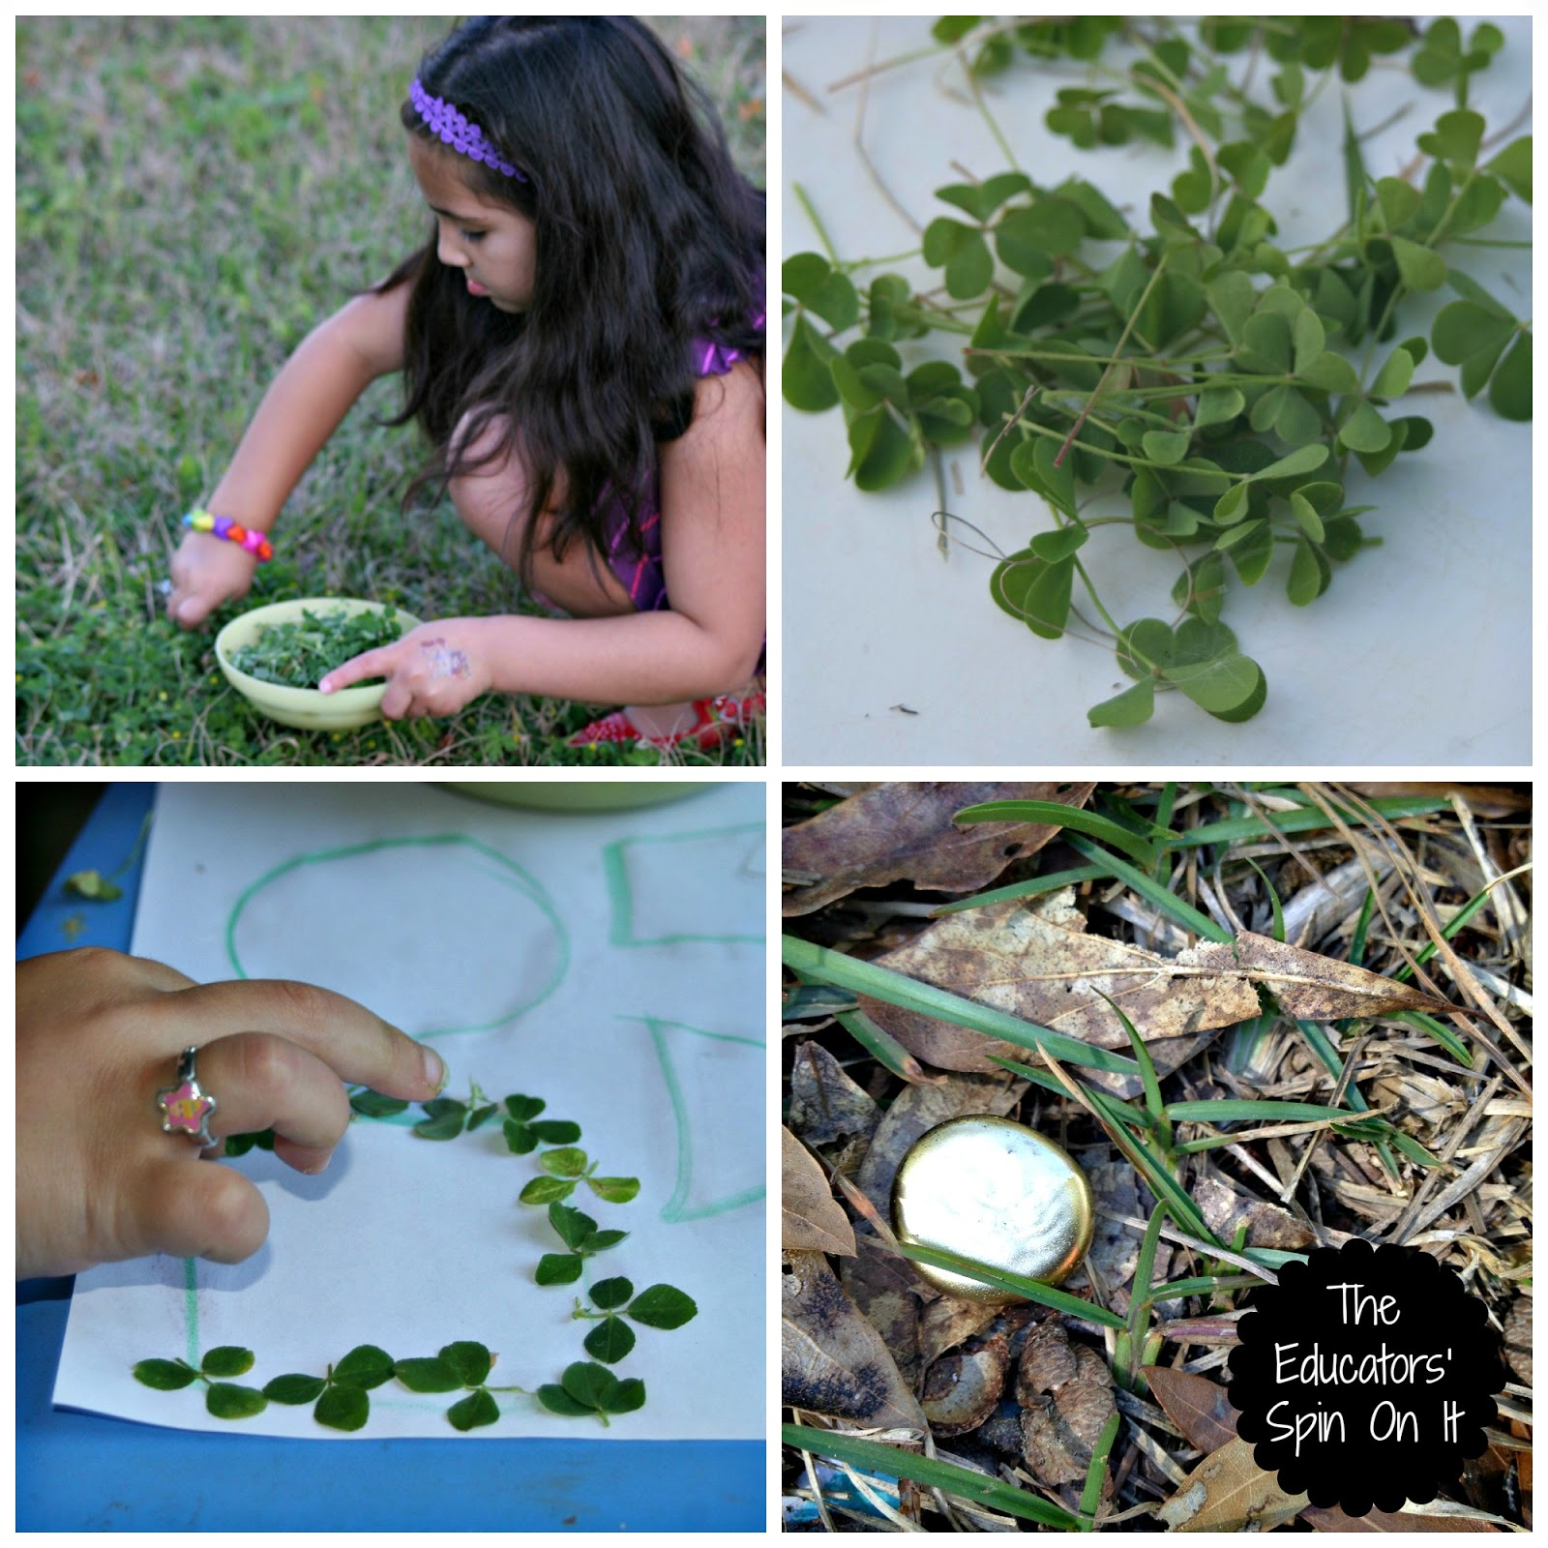
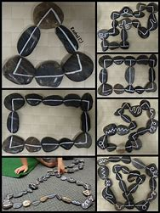
Shape We are learning to recognise shapes.
Practical ideas…
Draw pictures using circles and squares around the house.
Go on a shape hunt around the house and outdoors.
Make shapes on the ground using natural things.
Play shape hopscotch.
Play with blocks and make 3D models.
Make junk models using recyclable materials.

