Slide 2
What Is Personal Hygiene?
Personal hygiene is how we look after our bodies. Keeping ourselves clean and tidy makes us feel better about ourselves and also keeps us, and those around us, healthier!

Slide 3
What Does It Include?
Can you think what might be included in personal hygiene? Discuss:
Brushing our teeth;
Washing our hands;
Wearing clean clothes;
Showering or bathing regularly;
Keeping our noses clean;
Minimising the spread of germs where we can!

Slide 4
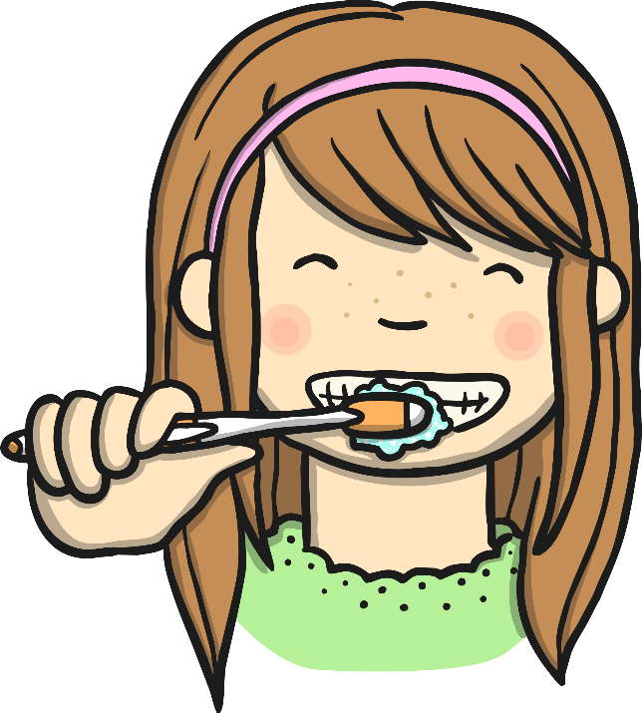
Brushing Our Teeth
It is recommended that we brush our teeth twice a day, for around
2 minutes.
We should visit the dentist every 6 months for a check up.
Brushing properly removes plaque. Plaque can cause cavities, toothache, gum disease and even our teeth to fall out!
It also gives us lovely fresh breath!

Slide 5
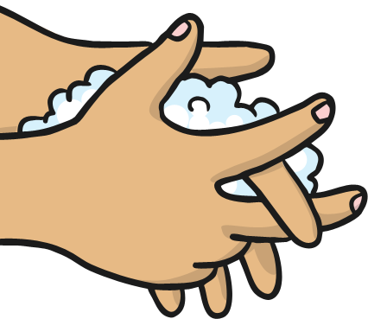
Washing Our Hands
Washing our hands is one of the simplest ways we can keep ourselves and those around us healthy.
Think about everything your hands touch in a day…
Computers screens and keyboards
Door handles and stair banisters
Toilet flushes
How many other people have touched these things too!

Slide 6
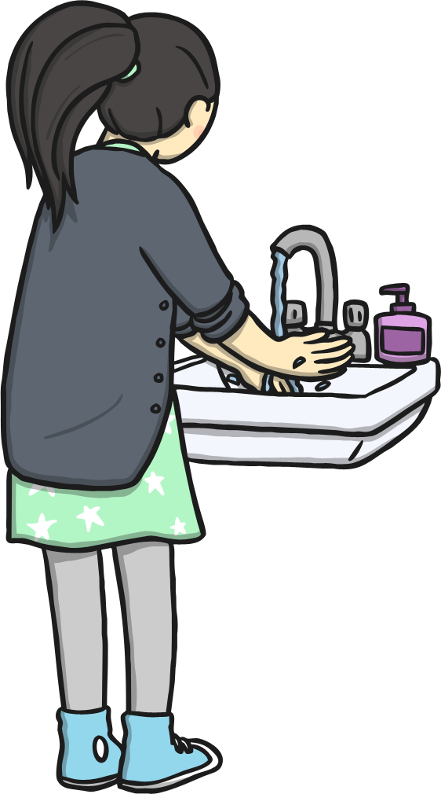
Handwashing
When we touch things, we pick up germs, which we can then spread by rubbing our eyes, putting things into our mouths, etc.
We can even spread them to our friends and family without realising. Some germs can make us feel unwell, from a cold to a tummy bug and more.
Washing our hands with clean, warm water and soap will kill off the germs and keep our hands clean.

Slide 7
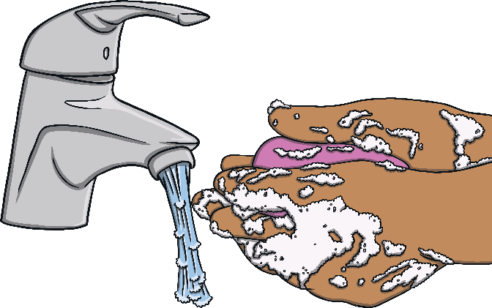
When Should We Wash Our Hands?
Can you think of times when its really important to wash your hands? Discuss!
When they are dirty!
Before we eat or help prepare food
After petting animals
After using the toilet
After we sneeze, cough or blow our noses
Before AND after visiting someone who is unwell

Slide 8
Don’t Forget About Your Nails
When washing our hands, it is important to keep our nails clean. Underneath our fingernails is a great place for germs to hide!
It’s best to keep your nails neatly trimmed and clean!
And try not to bite them…….

Slide 9
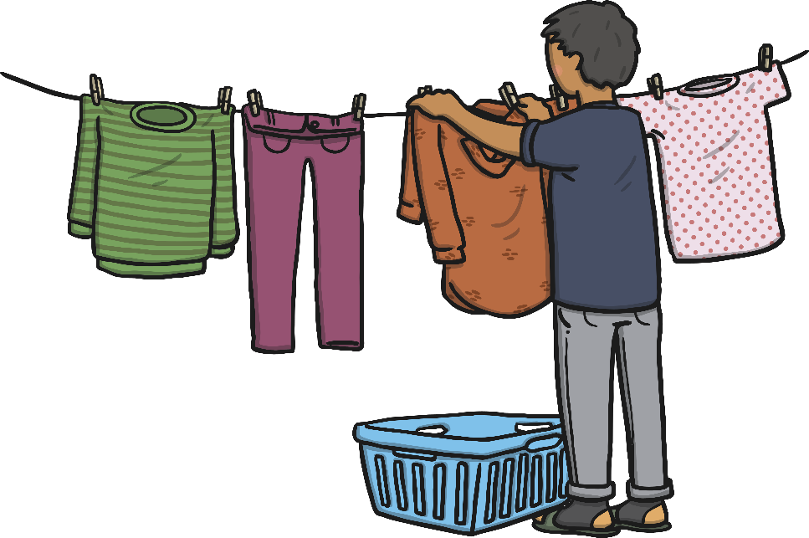
Clean Clothes
It is really important to wear clean clothes. If we wore the same thing all the time, they would get dirty and start to smell.
We don’t mean wear new, clean clothes every day, but if, for example, you wear the same trousers to school for a few days, make sure that you take them off as soon as you get home and let them air out for a while!

Slide 10
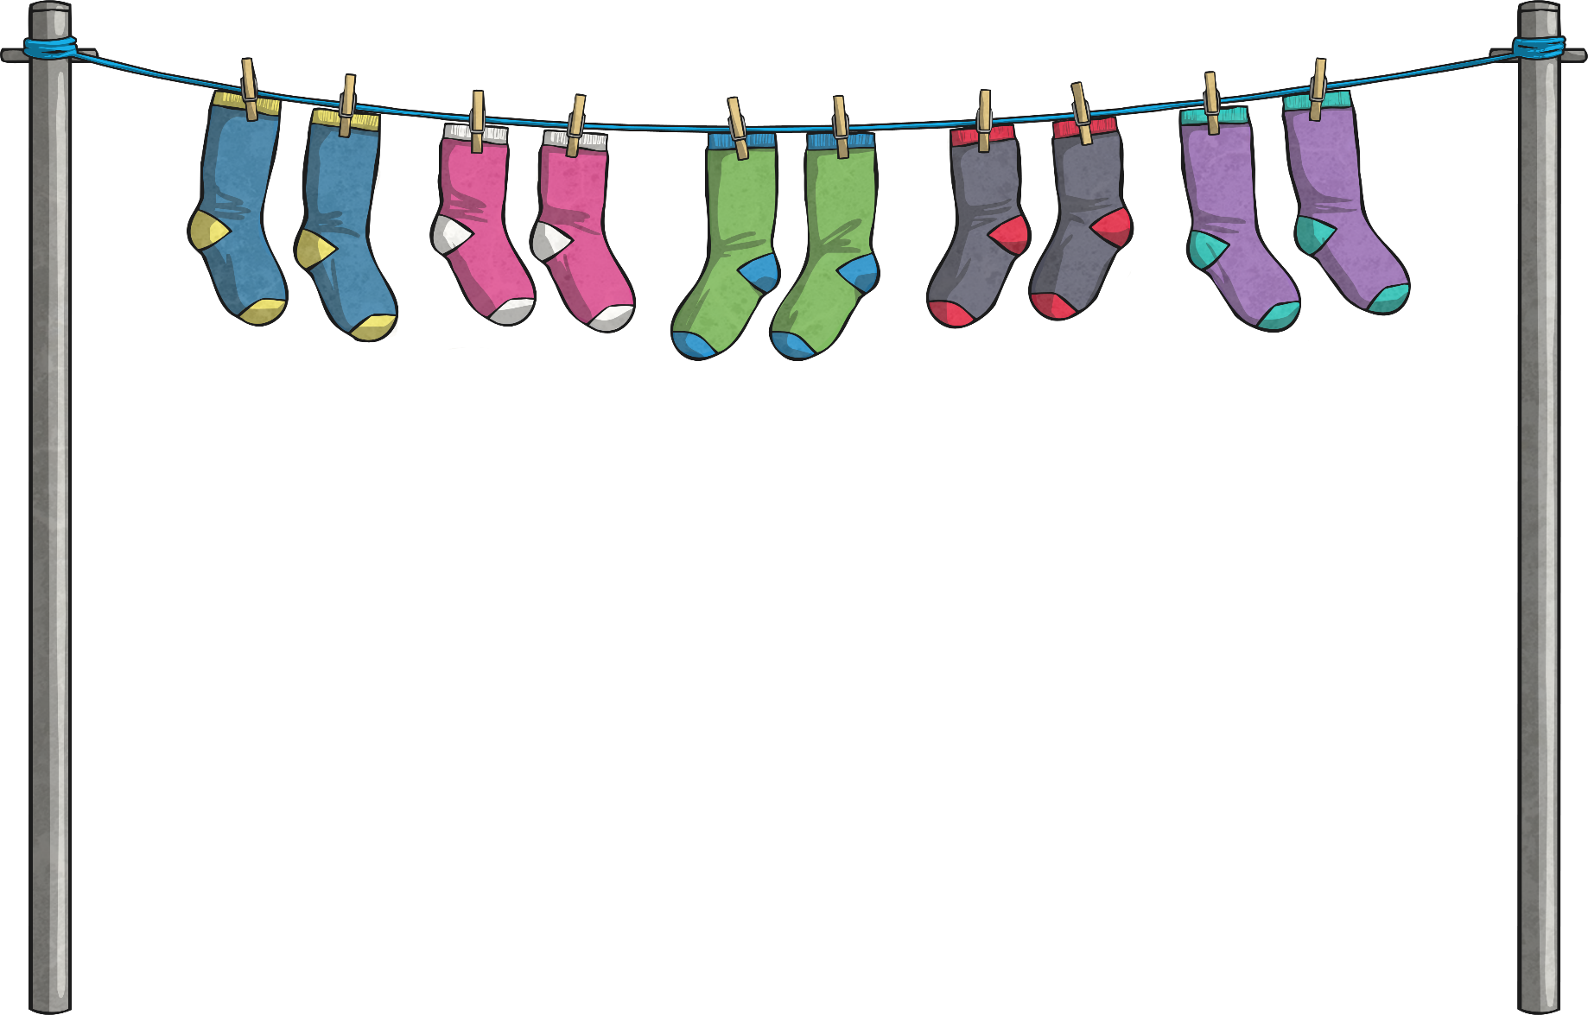
Don’t Forget Your Underwear!
Underwear is different. Underwear covers our personal parts, which can get the most sweaty.
This includes socks!! Our feet are covered in sweat glands and can get sweaty and smelly as we’re on our feet a lot!
Remember to change your socks and underwear every day! And put the dirty ones in the dirty washing basket! Don’t leave them on your bedroom floor! YUCK!

Slide 11
Showering or Bathing Regularly
Years ago, it was difficult to keep your whole body clean. Water had to be heated by the fire, a bath tub was filled and the whole family used the same bath water. Remember, families were bigger back then, sometimes with 6 or more children! Can you imagine being last to use the bath water?
Luckily, it’s very different nowadays! We have hot water straight out the shower or taps for the bath so there is no excuse not to shower regularly!
It is especially important to shower after we exercise.

Slide 12
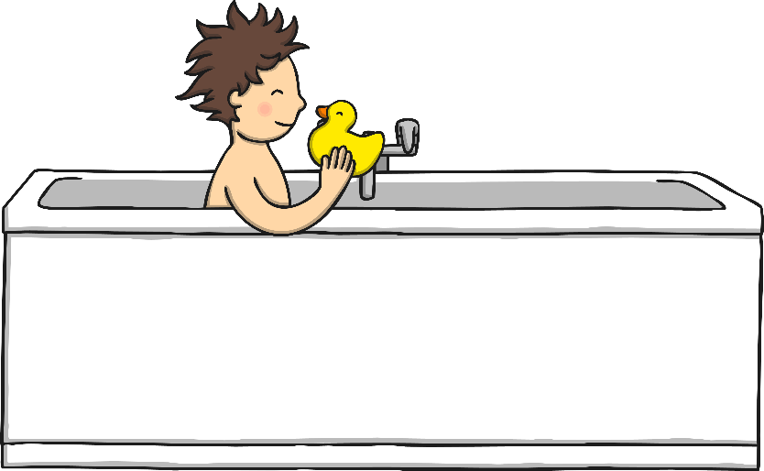
Scrub-a-dub-dub
When bathing or showering, remember to clean yourself properly
Think about the body parts which may need cleaned most frequently. Under our arms, between our legs and those feet with all the sweat glands!
To keep your hair clean, use shampoo. If we don’t wash our hair regularly, it can look greasy as oils start to build up on our scalp.

Slide 13
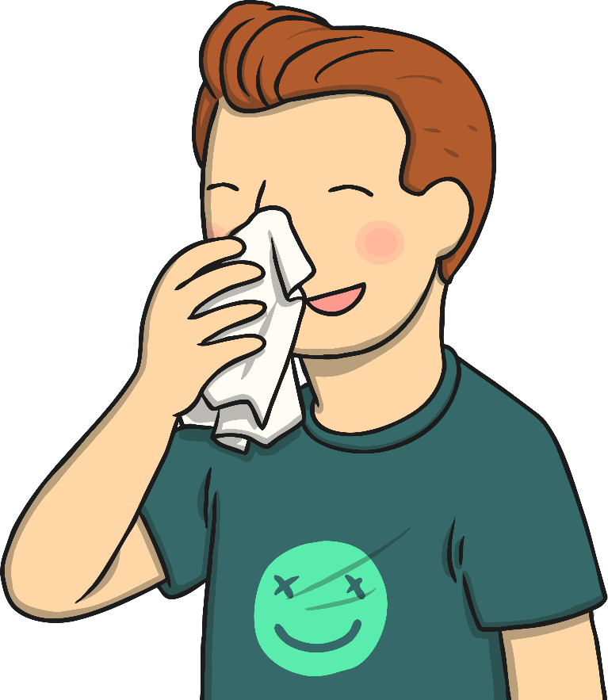
Keeping Our Noses Clean
Have you ever had a really runny nose? Or has it been really blocked and you feel like you can’t breathe through it?
It’s a horrible feeling, but we have all been there!
The only acceptable way of dealing with this is a tissue.
Sniffing, picking, wiping with sleeves… YUCK!

Slide 14
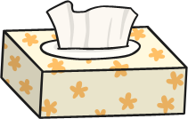
Using a Tissue
Bring a small packet of tissues with you to school. If you have a really bad cold, they can even stay at your desk!
However:
Dirty tissues must be binned or flushed down a toilet straightaway!
Don’t share used tissues with others.
Wash your hands after using a tissue.

Slide 15
Spreading Germs
Germs and bacteria spread. It’s a fact and we cant stop it, but we can try to minimise their spread. Following the tissue rules and washing our hands are really easy ways to minimise the germs we spread.
Can you think of any other ways?
Discuss:
covering our mouths when we sneeze or cough;
not sharing water bottles, etc;
not coming to school if you have a tummy bug and have been sick;
try not to touch our eyes, noses and mouths too much.

Slide 16
Activities
Germs and bacteria spread. It’s a fact and we cant stop it, but we can try to minimise their spread. Following the tissue rules and washing our hands are really easy ways to minimise the germs we spread.
Can you create a poster to show how to wash our hands?

