Slide 2
The Cross
At Easter, Christians celebrate the new life of Jesus.
They believe he died on the cross and
then came back to life again.
?
Did you know?
At Easter, Christians celebrate the new life of Jesus.

Slide 3
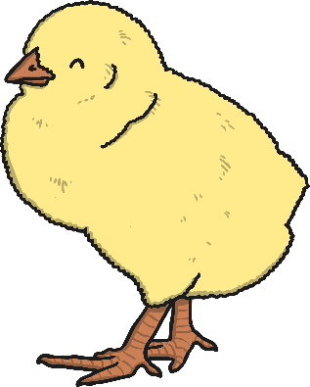
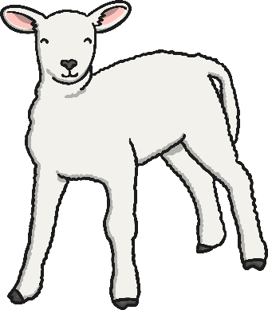
Chicks, Lambs and Buds
At Easter time, in the spring, the weather starts to become warmer and chicks hatch from their eggs.
Many animals give birth to their young at Easter time. The new baby animals are signs of new life at Easter.
You find lots of buds on many trees at Easter time. The buds contain new life.
Leaves and flowers grow from the buds.

Slide 4
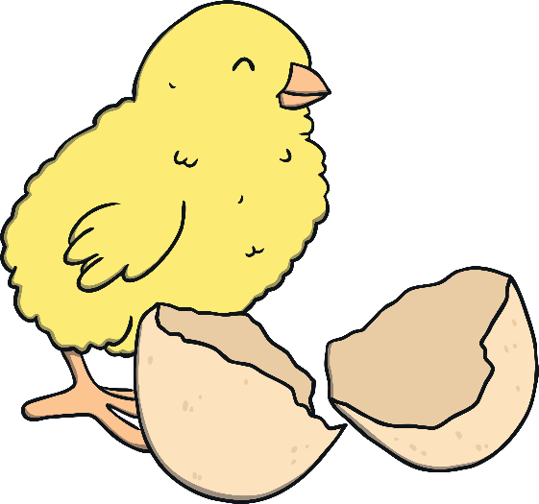
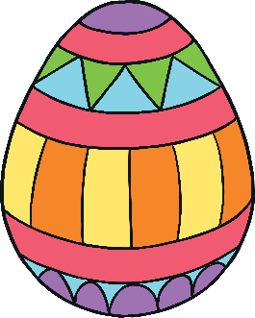
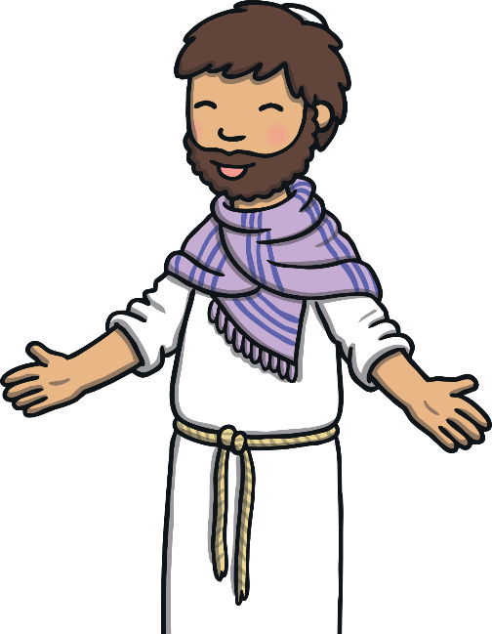
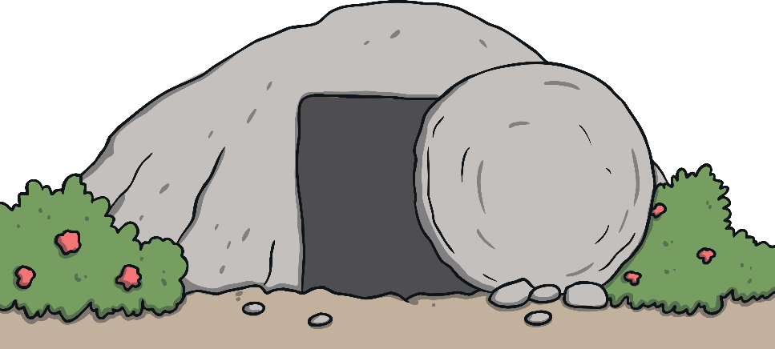
Easter Eggs
Easter eggs are the same shape as the eggs
that chicks hatch from at Easter time.
An egg cracking also makes some Christians think of Jesus breaking out of the tomb, where his body was put when he died.
It reminds them that Jesus came back to life.
It reminds them that Jesus came back to life.

Slide 5
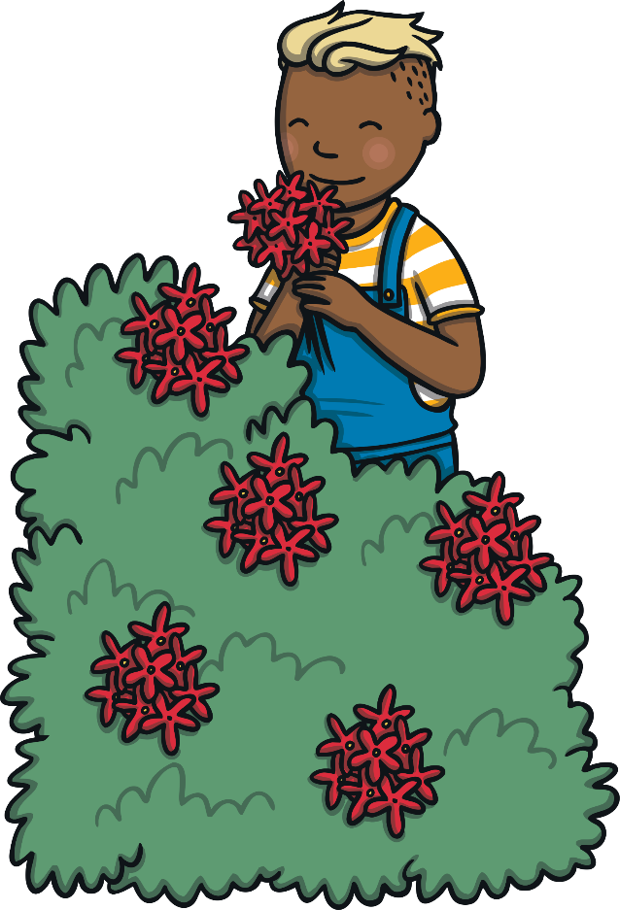
Daffodils
After the cold winter, at Easter time, it begins to get warmer and lots of new flowers grow.
Some people say their gardens have ‘come to life’ when they see all of the new flowers growing.

Slide 6
Frog Spawn
The frog spawn is the start of the new life.
Frog spawn is made up of thousands of eggs that develop into tadpoles.
The tadpoles then grow into frogs.

Slide 7
Signs of New Life at Easter Time
There are lots of signs of new life that you may see at Easter time.
Can you remember what they are?
Click on the question marks below.
?
?
?
?
?
?
?
Frog Spawn
Daffodils
Easter Eggs
Buds
Lambs
Chicks
The Cross

