Slide 8
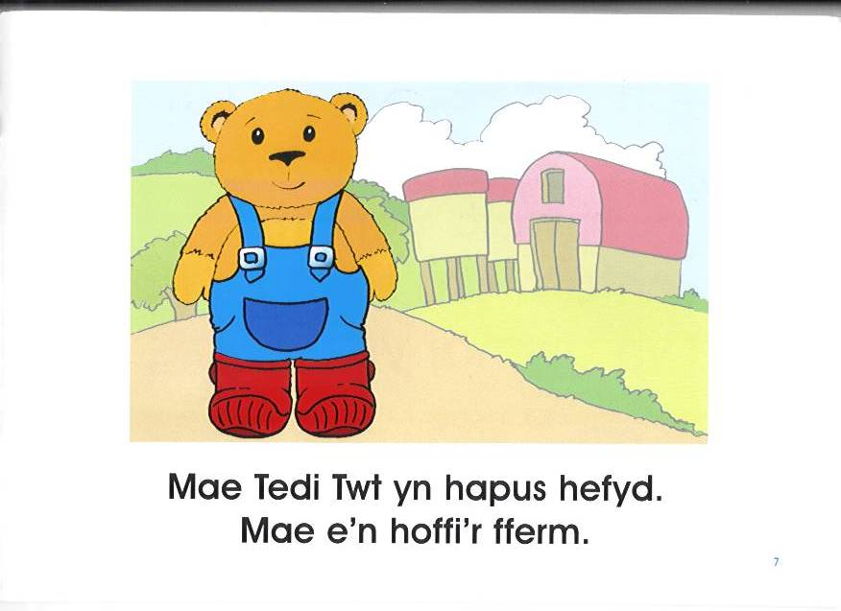

Slide 10
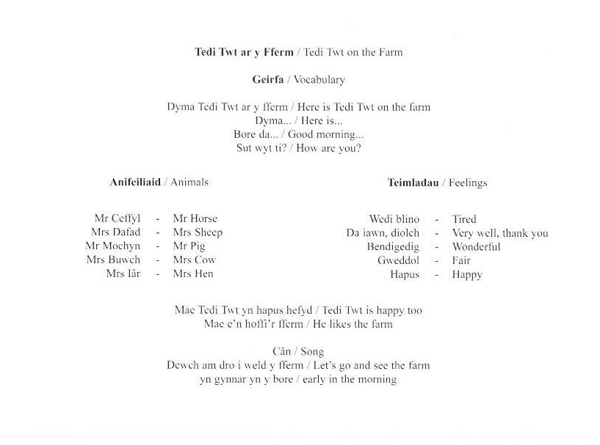

Slide 17
Activities
Can you read the story together?
Can you talk about the story?
Can you practise 'Sut wyt ti?' ?
Can you draw farm animals and label them?
Can you make a farm puppet show?

